Slide 1








VORTEXA
3.0
12 HRS HACKATHON
POWERED BY A.I.R.S
DOMAIN & NO: Domain 5 | E-01
PROBLEM STATEMENT TITLE:
LearnLoop AI: Adaptive AI Tutor & Misconception Detector
TEAM NAME: EncodeX
TEAM ID: onspot 5

Slide 2


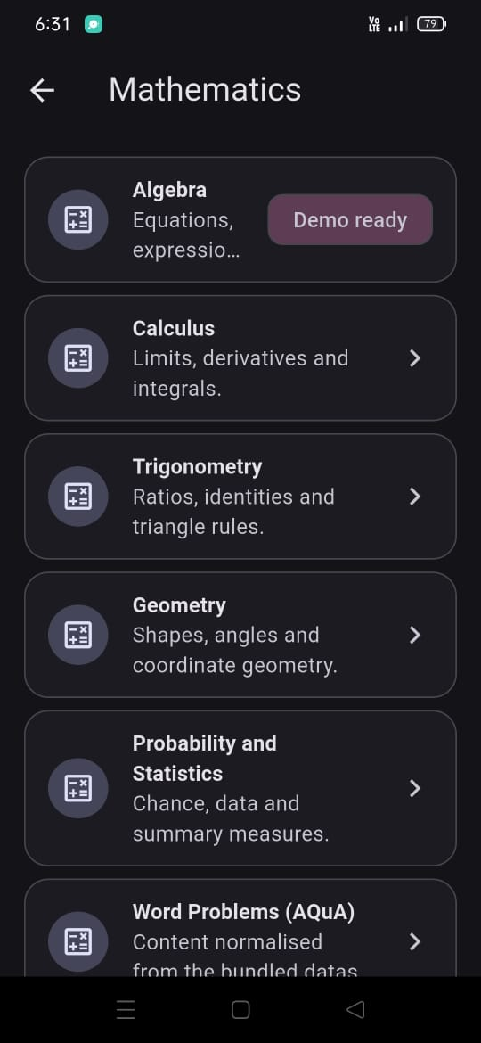
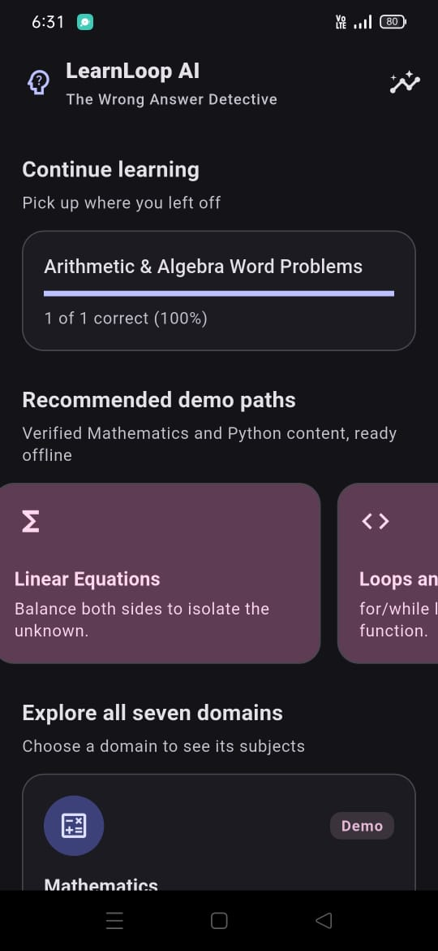



PROBLEM STATEMENT
THE PROBLEM
• Most practice apps show correct/incorrect feedback but do not investigate the reason for an error.
• The same wrong answer may reflect a misconception, a missing step, a knowledge gap or a one-off slip.
• A confident diagnosis from one answer can mislead learners; cloud dependence can also exclude offline users.
THE E-01 NEED
• Move from response → likely cause → targeted support.
• Ask a clarifying probe when the evidence is weak; let learners disagree.
• Verify understanding with a fresh, hint-free question and track progress locally.
PROJECT GOAL
A transparent, offline-first learning loop that diagnoses the response—not the learner—and checks whether the feedback worked.
SUBJECT LIST
LEARNER HOME

Slide 3

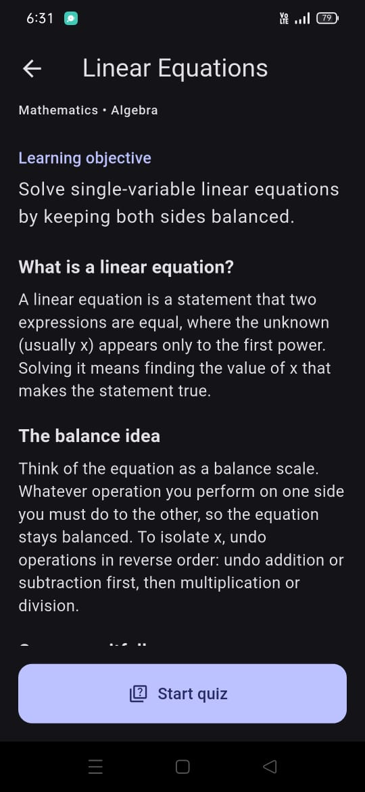
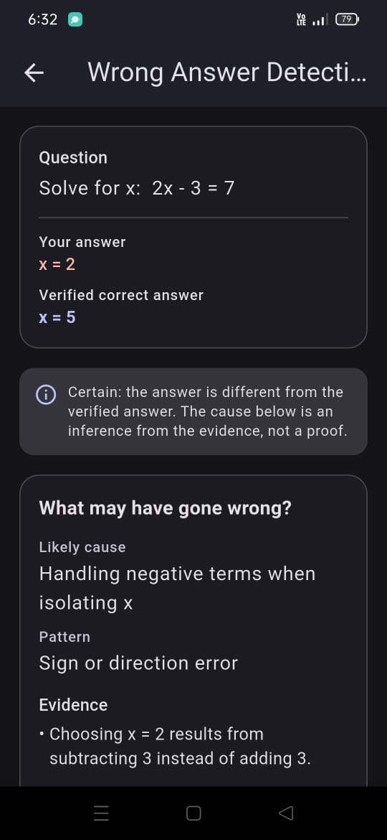
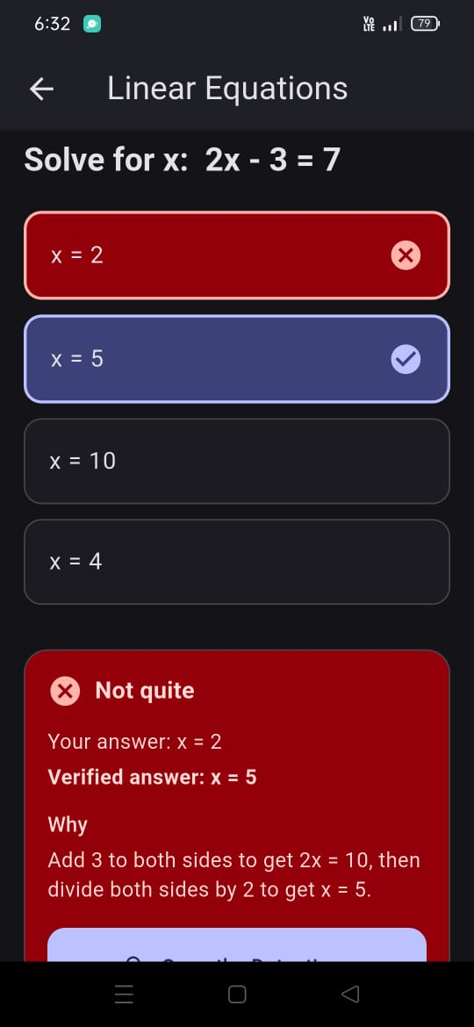


IDEA TITLE / PROPOSED SOLUTION
1 INVESTIGATE
• Check correctness with deterministic subject rules.
• Extract rule flags and response context.
• Rank possible error causes with a compact on-device classifier.
• If evidence is weak, ask a short clarifying probe.
2 ADAPT
• Explain the error using the evidence.
• Contrast the incorrect rule with the correct one.
• Select a targeted hint, worked example or scaffolded activity.
• Allow the learner to disagree with a tentative diagnosis.
3 VERIFY & UPDATE
• Ask a fresh question in a different form, with no hints.
• Update mastery only from verification evidence.
• Save attempts, diagnosis status and review plan in local SQLite.
• Keep the core workflow available offline.
1 INVESTIGATE
→
2 ADAPT
→
3 VERIFY

Slide 4




TECHNICAL APPROACH
APP & LEARNING ENGINE
• Flutter + Dart Android-first client; Riverpod state and go_router navigation.
• Shared subject-independent engine: answer checker, feature extractor, uncertainty gate, explanation composer, adaptive planner and mastery tracker.
• Algebra and Python modules supply content, evaluators, probes, hints and verification questions.
AI, DATA & OFFLINE DESIGN
• Python / scikit-learn workbench; export model parameters and metadata as JSON for Dart inference.
• SQLite via sqflite stores attempts, diagnoses, mastery and review schedules.
• Bundled content and model assets; no network required for core learning flow.
• If model parity fails, use deterministic rules and probes.
DIAGNOSIS OUTCOMES
Conceptual misconception • Procedural error • Calculation/careless slip • Knowledge gap • Uncertain
EVALUATION PLAN
Accuracy • Macro-F1 • Confusion matrix • False-diagnosis rate • Coverage / abstention • Python–Dart golden-vector parity
HOW ONE ANSWER FLOWS THROUGH THE ENGINE
1
2
3
4
5
6
Learner answer
Choice, numeric, algebra or code-output
Rule check
Deterministic correctness first
Feature extraction
Rule flags and response context
Classifier + gate
Ranks causes; abstains if unsure
Explain + adapt
Evidence-based hint or example
Verify + update
Fresh question; mastery saved in SQLite
›
›
›
›
›

Slide 5



FEASIBILITY AND VIABILITY
MVP SCOPE: SIX SKILLS
• Mathematics / Algebra: binomial squares, linear equations, exponent laws.
• Computer Science / Python: range() and loop bounds; assignment and list aliasing; / vs // and = vs ==.
• Question formats: multiple choice, numeric, algebraic and code-output.
12-HOUR DELIVERY STRATEGY
• Freeze contracts and IDs early; build the rules/content baseline first.
• Integrate diagnosis, adaptation, verification and SQLite by the integration checkpoint.
• Feature-freeze before final testing; protect offline flow and uncertainty handling.
VIABILITY & FALLBACK
The architecture supports future subject modules through a common contract. Five additional domains are planned extensions, not part of the working MVP. If the exported model cannot be validated against Dart inference, retain the safer rules-and-probes fallback.
DELIVERY ROADMAP
1
2
3
4
Contracts + content
Freeze IDs and contracts early; build rules and content baseline
Rules, probes + model
Evaluators, probes and the compact on-device classifier
Integrate
Diagnosis, adaptation, verification and SQLite by the checkpoint
Freeze + demo
Feature-freeze, test the offline flow, rehearse the demo
›
›
›

Slide 6




IMPACT AND BENEFITS
FOR LEARNERS
• Understand the likely reason an answer went wrong.
• Get targeted hints and practice rather than generic retries.
• See progress based on fresh verification evidence.
• Use the core flow on a basic Android phone without internet.
FOR EDUCATORS
• Review skill mastery and misconception status.
• Inspect evidence and model version behind a diagnosis.
• Use the learner's history to guide revision.
• Class-level views are a future extension.
HOW IMPACT WILL BE TESTED
• Use matched pre/post assessments and learner feedback in a future pilot.
• Report sample size, score change and study limitations.
• No learning gain, accuracy or latency is claimed until measured.
Expected benefit: useful, evidence-based feedback that responds to the learner’s reasoning.
AT A GLANCE
OFFLINE-FIRST
Core learning flow needs no network
6 MVP SKILLS
Algebra and Python modules first
7 DOMAINS
Planned on one shared engine contract
LOCAL SQLITE
Attempts, mastery and reviews stay on device

Slide 7



DIFFERENTIATOR
DIAGNOSTIC HONESTY
• A wrong answer is a clue, not proof of reasoning.
• Diagnosis remains a hypothesis until supported; otherwise the app abstains or asks a probe.
• Learners can disagree; no high-stakes grading.
CLOSED-LOOP + PRIVACY
• Diagnosis → targeted adaptation → fresh, hint-free verification.
• Local SQLite records; privacy-by-default offline operation.
• Reusable engine with subject-specific modules instead of separate systems.
EXAMPLE
Algebra: (x + 3)² = x² + 9 may indicate a missing cross term—but it could be a slip or a deeper gap. LearnLoop asks the learner to expand (x + 3)(x + 3), then confirms, revises or withholds the diagnosis based on the response.
WHY IT STANDS OUT
TYPICAL PRACTICE APP
• Marks the answer right or wrong
• Offers the same generic hint to everyone
• Often depends on the cloud
LEARNLOOP AI
• Investigates the likely cause of the error
• Abstains or asks a probe when evidence is weak
• Verifies the fix and works fully offline
VS

Slide 8










THANK YOU!
Game’s
Still On
VORTEXA 3.0
AIRS

